Slide 1
Records Management and Retention Training
April 2019

Slide 2
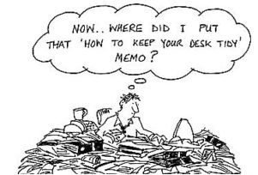
Public Records Retention- why are we talking about this?
MassTech produces many types of documents that fall under the Commonwealth public record retention requirements.
The goal is to help you understand what you have, what you can dispose of, and what must be retained.
This will not only make MassTech compliant, but will assist you in cleaning out offices, cubicles, file cabinets and computer files.

Slide 3
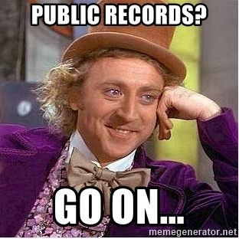

Slide 4
What is a Public Record?
For purposes of the MA Public Records Act, “public records” include all books, papers, maps, photographs, recorded tapes, financial statements, statistical tabulations, or other documentary materials or data, regardless of physical form or characteristics, made or received by MassTech. As a result, any information submitted to MassTech by a grant applicant, recipient grantee, respondent to a request for response (including, but not limited to an RFQ, RFP and RFI), contractor, or any other party, is subject to document retention requirements as set forth in the Public Records Act.
You should consider every document MassTech produces, reviews or receives as part of MassTech “business” as a public record until determined otherwise.
Electronic records are treated the same as paper records for disclosure purposes. This includes Email communications and text messages – regardless of the device (i.e. personal phone or home computer). So, a text message sent from your personal phone related to work is considered a public record.

Slide 5
Public Record Requests & Exemptions
The Legislature has created numerous exemptions to the public records law, which provide the basis for withholding records completely or in part.
This does not mean that if a document falls within an exemption it is not a public record. Rather, the document is protected from disclosure should someone from the public request it.
If you receive a request for public records from someone outside of government, please forward the request to Jennifer Saubermann or Brian Noyes.
How do I know whether I’ve received a public records request?
  A request can be verbal – over the phone or in person – or written
  The requester is asking for a document or other form of public record – not just asking a question
  We are required to report all records requests to the Secretary of State’s Office – so if you have a question just ask Jennifer or Brian

Slide 6
How long do I need to keep my records?
Some perspective: The Massachusetts Statewide Records Retention Schedule, created by the Secretary of State’s Office is 226 pages – we have narrowed it down to this short presentation!
Depending on content, records will fall into one of three retention timeframes:
  Can be disposed of immediately or when administrative use ends
  Must be kept for a minimum of seven (7) years
  Must be kept permanently

Slide 7
What can I throw out or delete now?
Common records you may have that can be disposed of when
their administrative use ends, such as:
  Duplicate materials and all duplicates of 'official copies'
  Non-MassTech published announcements
  Published reports produced by other entities
  Purchased data from other sources
  Telephone messages that are non-substantive (scheduling, “just following up”)
    If they are substantive in nature (policy discussion, legal, HR), then you must save the message our phone system delivers to your email (keep for 7 years)
  Catalogues, journals, or other printed matter used for information purposes
  Routine letters of transmittal and "for your information" correspondence
  Public appearance documents, speeches and writings

Slide 8
What can I throw out or delete now?
Continued
  Special event records from visits, ceremonies, lectures or tours
  Notes or working papers once a project is completed, unless they
  provide more complete information than the final report/document
  Draft documents, unless they provide important information not contained in the final version
  Threaded emails with program, policy or substantive information as long as the final version is retained (see slide 17 for more information)
  Purchase orders (unless containing ongoing terms and conditions, or related to a contract)
  SPAM emails

Slide 9
What do I need to keep for seven (7) years?
  Examples are:
  Official mail and email correspondence from/to customers, grantees and service providers, including letters, attachments, pictures
  General correspondence associated with company administrative practices, and policy development correspondence
  Project requests, progress notes, status reports, meeting documentation that contains substantive program information, change and variance requests, issue logs/risk logs/decisions made, and closeout records
  Stakeholder contact details
  Deliverable documents
  Procurement documents and responses

Slide 10
What do I need to keep for seven (7) years? Continued
  Program and project team guidelines, instructions, notes, etc.
  Open meeting announcements and agendas
  Public record requests
  Contracts and related documents
  Routine accounting records and copies of payment support documentation
  Insurance policies
  Facilities fire, safety and environmental monitoring records
  Facilities, equipment, vehicle and property management and inventory
  records
Unless private information is contained within these records, they do not
need to be shredded.

Slide 11
What needs to be kept permanently?
Examples are:
Records related to the creation and governance of MassTech
Records related to the creation of new programs and committees at MassTech, including organizational charts, agendas and meeting notes
Board and Executive Committee meeting records and handouts
Official meeting minutes (*must be kept in hard copy)
Official final media and press releases
Records pertaining to MassTech litigation
Payroll System Records- General ledgers and payroll registers
Telephone directories and staff listings (until superseded)
MassTech official policy and procedures (until superseded)
*Employee personnel case files, including applications, resumes, offer and acceptance letters (keep 50 years after separation)

Slide 12
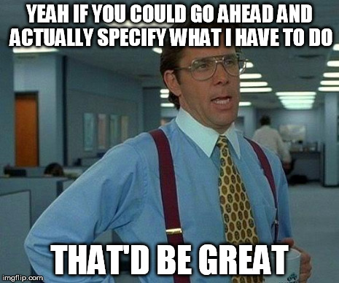
Who is responsible for maintaining the official records of what?

Slide 13
Record-keeping Responsibilities by Department
Executive Director/Executive Assistant or Secretary of the Board
MassTech governance records, documentation of monitoring and decision making including all notes, memos, reports and correspondence, board meeting minutes and handouts
Division Directors
Program creation and policy records, program committee establishment documentation
Program Managers
All grantee, customer and vendor documents (excluding contracts) and communications, including progress reports and deliverables
Finance Department
Budget documents, purchase orders, audit files, payroll records
Human Resources Department
Personnel files, HR policies and procedures, job applicant information and hiring process records, interview notes

Slide 14
Record-keeping Responsibilities by Department Continued
Communications Department
  Press releases, program announcements, public records requests
Legal Department
All contracts and related documentation, RFP and solicitation documents
Information Technology Department
Email and electronic record procedures, website documentation records, email and electronic record backups
Facilities Department
Facilities management records (daily routine administration of the facilities and grounds), equipment use and maintenance information, building plans, systems inspection reports

Slide 15
Do records have to be in a specific format?
No, there is no specific format; they can be either electronic or
hardcopy as long as the record you keep contains all the information.
  EXCEPTION: Meeting minutes– a hard copy must be kept permanently.
Electronic records meet MA record retention requirements as long as
the record is accurate, legible and accessible.
You do not need a hardcopy if there is an accurate, legible and accessible electronic record. Just keep the most comprehensive version. One copy is all that’s needed.
Where do I keep my records?
Whether hardcopy or electronic, the records should be kept in an organized fashion in a location where they are accessible if needed.
If you have something that you believe belongs to another department please forward on. For example, notes taken while interviewing potential MassTech employment candidates should be given to HR for retention.

Slide 16
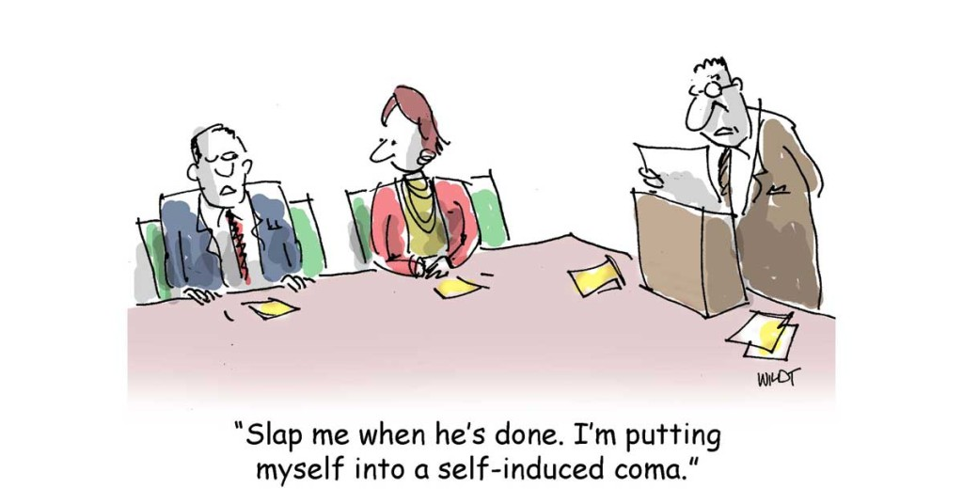

Slide 17
So what about email?
All the same types of documents can be contained in electronic form in email
All the same retention periods should be followed- it is the content of the email or attached document that determines retention, not the form
Keep any email with substantive content or discussions about projects, programs or policies
If an email is threaded which do I keep?
  The top thread
  If an email thread is split due to responding to emails out of sequence, it may be necessary to keep multiple emails in that conversation.
Retaining internally created attachments is the responsibility of the creator
Retaining externally created attachments is the responsibility of the Program Manager

Slide 18
How should I retain an email?
Leave it in your inbox: This preserves the email, but is bad from an organizational and accessibility standpoint
Move it to another folder: This helps with keeping email organized, and helps your email work better. This is not very accessible, however, as only you have access.
Save it to a network location: This is preferred as it is organized and accessible
What is meant by a network location? Not your desktop, not your “My Documents” folder. A network location would be the S:, J: or F: drives, for example.
How to save email? Save the message in the original form. This preserves all the content, such as where it really came from and who received it. How?
  Save As “Outlook Message Format – Unicode”
  If sent to a distribution list you should expand the list before saving.
Save any substantive attachments separately in a network folder.

Slide 19
What happens to deleted email?
Email is backed up twice a week
When you delete an email, even if you hard delete it, it is not really gone
Deleted items are kept for 14 more days and can be retrieved if needed
If you have many deleted items in your mailbox, IT can help with settings that will manage deleted items automatically

Slide 20
What about text messages?
Please avoid having any substantive policy or program conversations via text.
If you do, these messages are now affected by document retention policies.
To save the text message you will have to take a screen shot and then email that screen shot to your MassTech email address. The screen shot can then be saved in the appropriate network drive location.

Slide 21
How do I manage electronic records?
What if I can’t determine what to do with a record?
When in doubt, put the record aside and check with:
Jennifer Saubermann, Acting General Counsel, ext. 204
Kelly Kleanthous, Contracts Attorney, ext. 681
Any questions, contact:
Dan Mushrush, Information Technology Administrator, ext. 265
Kim Jacobs, Desktop Specialist, ext. 272

Slide 22
Clean-Up Day
Clean Up Day will be happening in May – further details will be circulated soon
What should I do on clean-up day?
  Organize your office to eliminate visible piles and clutter
  Go through file cabinets and drawers
  Assist with clean-up in common areas (copy areas, storage and supply cabinets, kitchen areas) and vacant offices
What do I do with items I no longer need?
  You should dispose of them based upon guidelines provided
    If you have files to be boxed, please label them on an end visible when shelved, with the following–Division, Program, Type of Documents, Timeframe of documents
    A process or temporary storage area will be identified for staff in Boston who have boxes to be transported to Westboro

Slide 23


